Slide 1

Lemon Grove City Council Virtual Meeting
PLEASE MUTE ALL DEVICES
Meeting is recorded for the purpose of drafting meeting minutes.
Audio of the meeting is uploaded to the City website within 72 hours following meeting.

Slide 2
CALL TO ORDER

Slide 3


Slide 4
CHANGES TO THE AGENDA

Slide 5
PRESENTATION

Slide 6
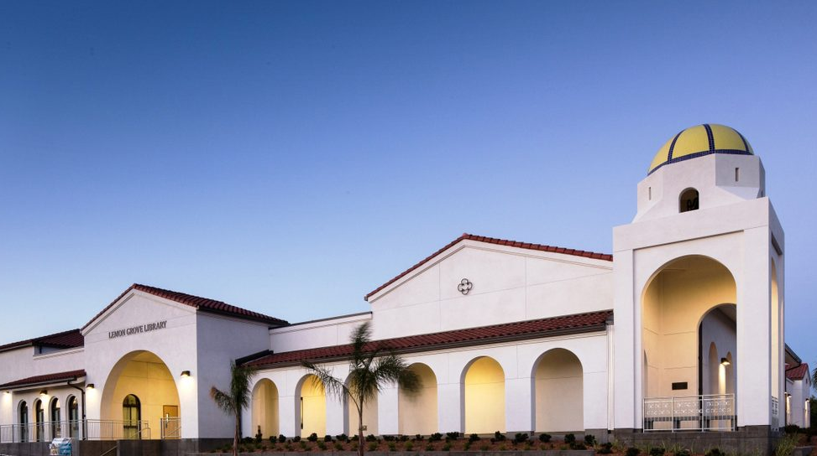
La Mesa Library City Council Update
Lemon Grove Library
City Council Update
Laura Mendez
Branch Manager
Chelsie Harris
Branch Manager
Notes:
Good evening Mayor, City Council, and City staff – thank you for this opportunity to speak.
I’m Laura Mendez, Branch Manager of the Lemon Grove Library. I’m here to share some of the County Library’s initiatives and accomplishments and give a snapshot of how the Lemon Grove Branch is doing.

Slide 7
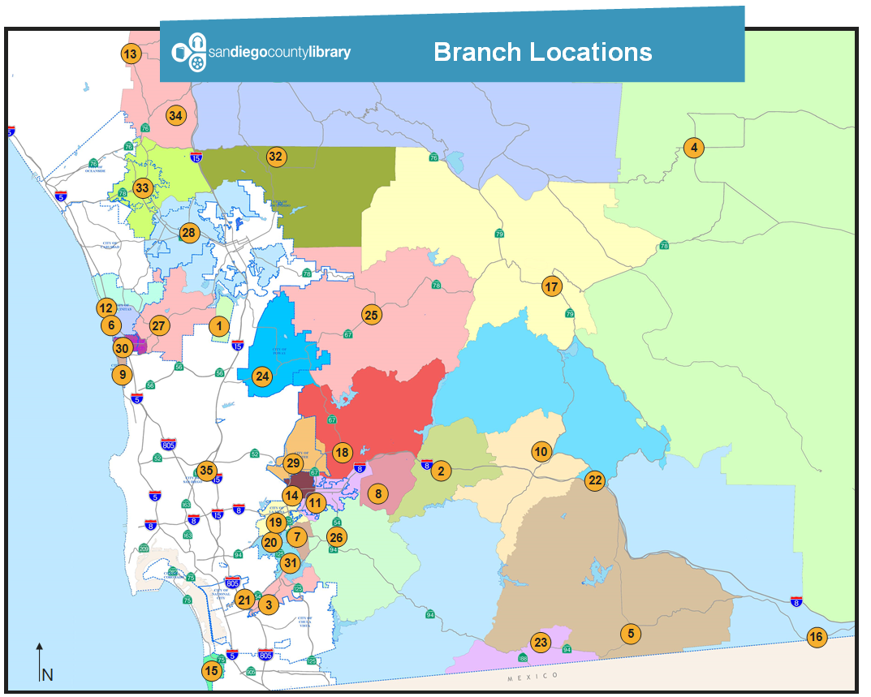
San Diego County Library
33 branches
2 bookmobiles
4 self-service kiosks
Notes:
But first, I wanted to share what being part of the County Library system means to Lemon Grove residents.
Lemon Grove is 1 of 33 libraries in this system, which also has 2 bookmobiles and 4 24/7 self-service kiosks.
The County Library serves 11 of the County’s 18 incorporated cities and all of the unincorporated areas of the County. The map on the screen shows our locations.
This means that…
Each library has stable funding: the County Library is funded by a dedicated portion of the property taxes in the cities and communities we serve.
Each community enjoys the collective expertise and innovation of more than 300 library professionals.
We have greater opportunities for partnerships & grants by organizations that are attracted to the scale and impact of a large library system. For example, SDCL is a member of Circuit and Link+, which are borrowing agreements with other libraries that give our customers access to over 40 million titles in addition to SDCL’s 1.4 million.

Slide 8
SDCL’s Mission Statement
“We celebrate our communities and dedicate our passion and expertise to help you create your own story.”
- The San Diego County Library Staff
Notes:
The County Library is launching a new Strategic Plan this year.
Our mission statement is: We celebrate our communities and dedicate our passion and expertise to help you create your own story.
We have four Guiding Principles as part of our new Strategic Plan: Learn, Energize, Read, and Create. Everything we do fits into one of these four Principles.

Slide 9


SDCL’s Guiding Principles
Learn
We promote learning, exploration, and discovery for fulfillment and personal growth.
Notes:
Our first Guiding Principle is:
Learn. We promote learning, exploration, and discovery for fulfillment and personal growth.
Here are just a few of the ways our staff has been guided by the Learn principle:
Library High School fosters achievement and builds bright futures by conferring accredited high school diplomas to adults whose education was interrupted. Please feel free to offer this program to any of your constituents or community partners. Just send them to LibraryHighSchool.org to sign up. We can also provide you flyers for distribution. This program has continued to operate through the pandemic.
Under normal circumstances, the library has made space available for after-school tutoring through the SDSU Pathways Program. Sponsored in part by our Friends of the Library president, Pathways links students that may be struggling academically with “near-peer” coaches for tutoring both in the classroom, and after school in our teen study rooms. This is a beautiful example of collaboration between the Library, the School District, and SDSU.
Customers can also learn new skills through Lynda.com, a LinkedIn product. Lynda offers thousands of courses and certification programs in business, technology, and creative skills. SDCL cardholders, including e-cardholders, now have access to this fantastic resource at no cost.

Slide 10
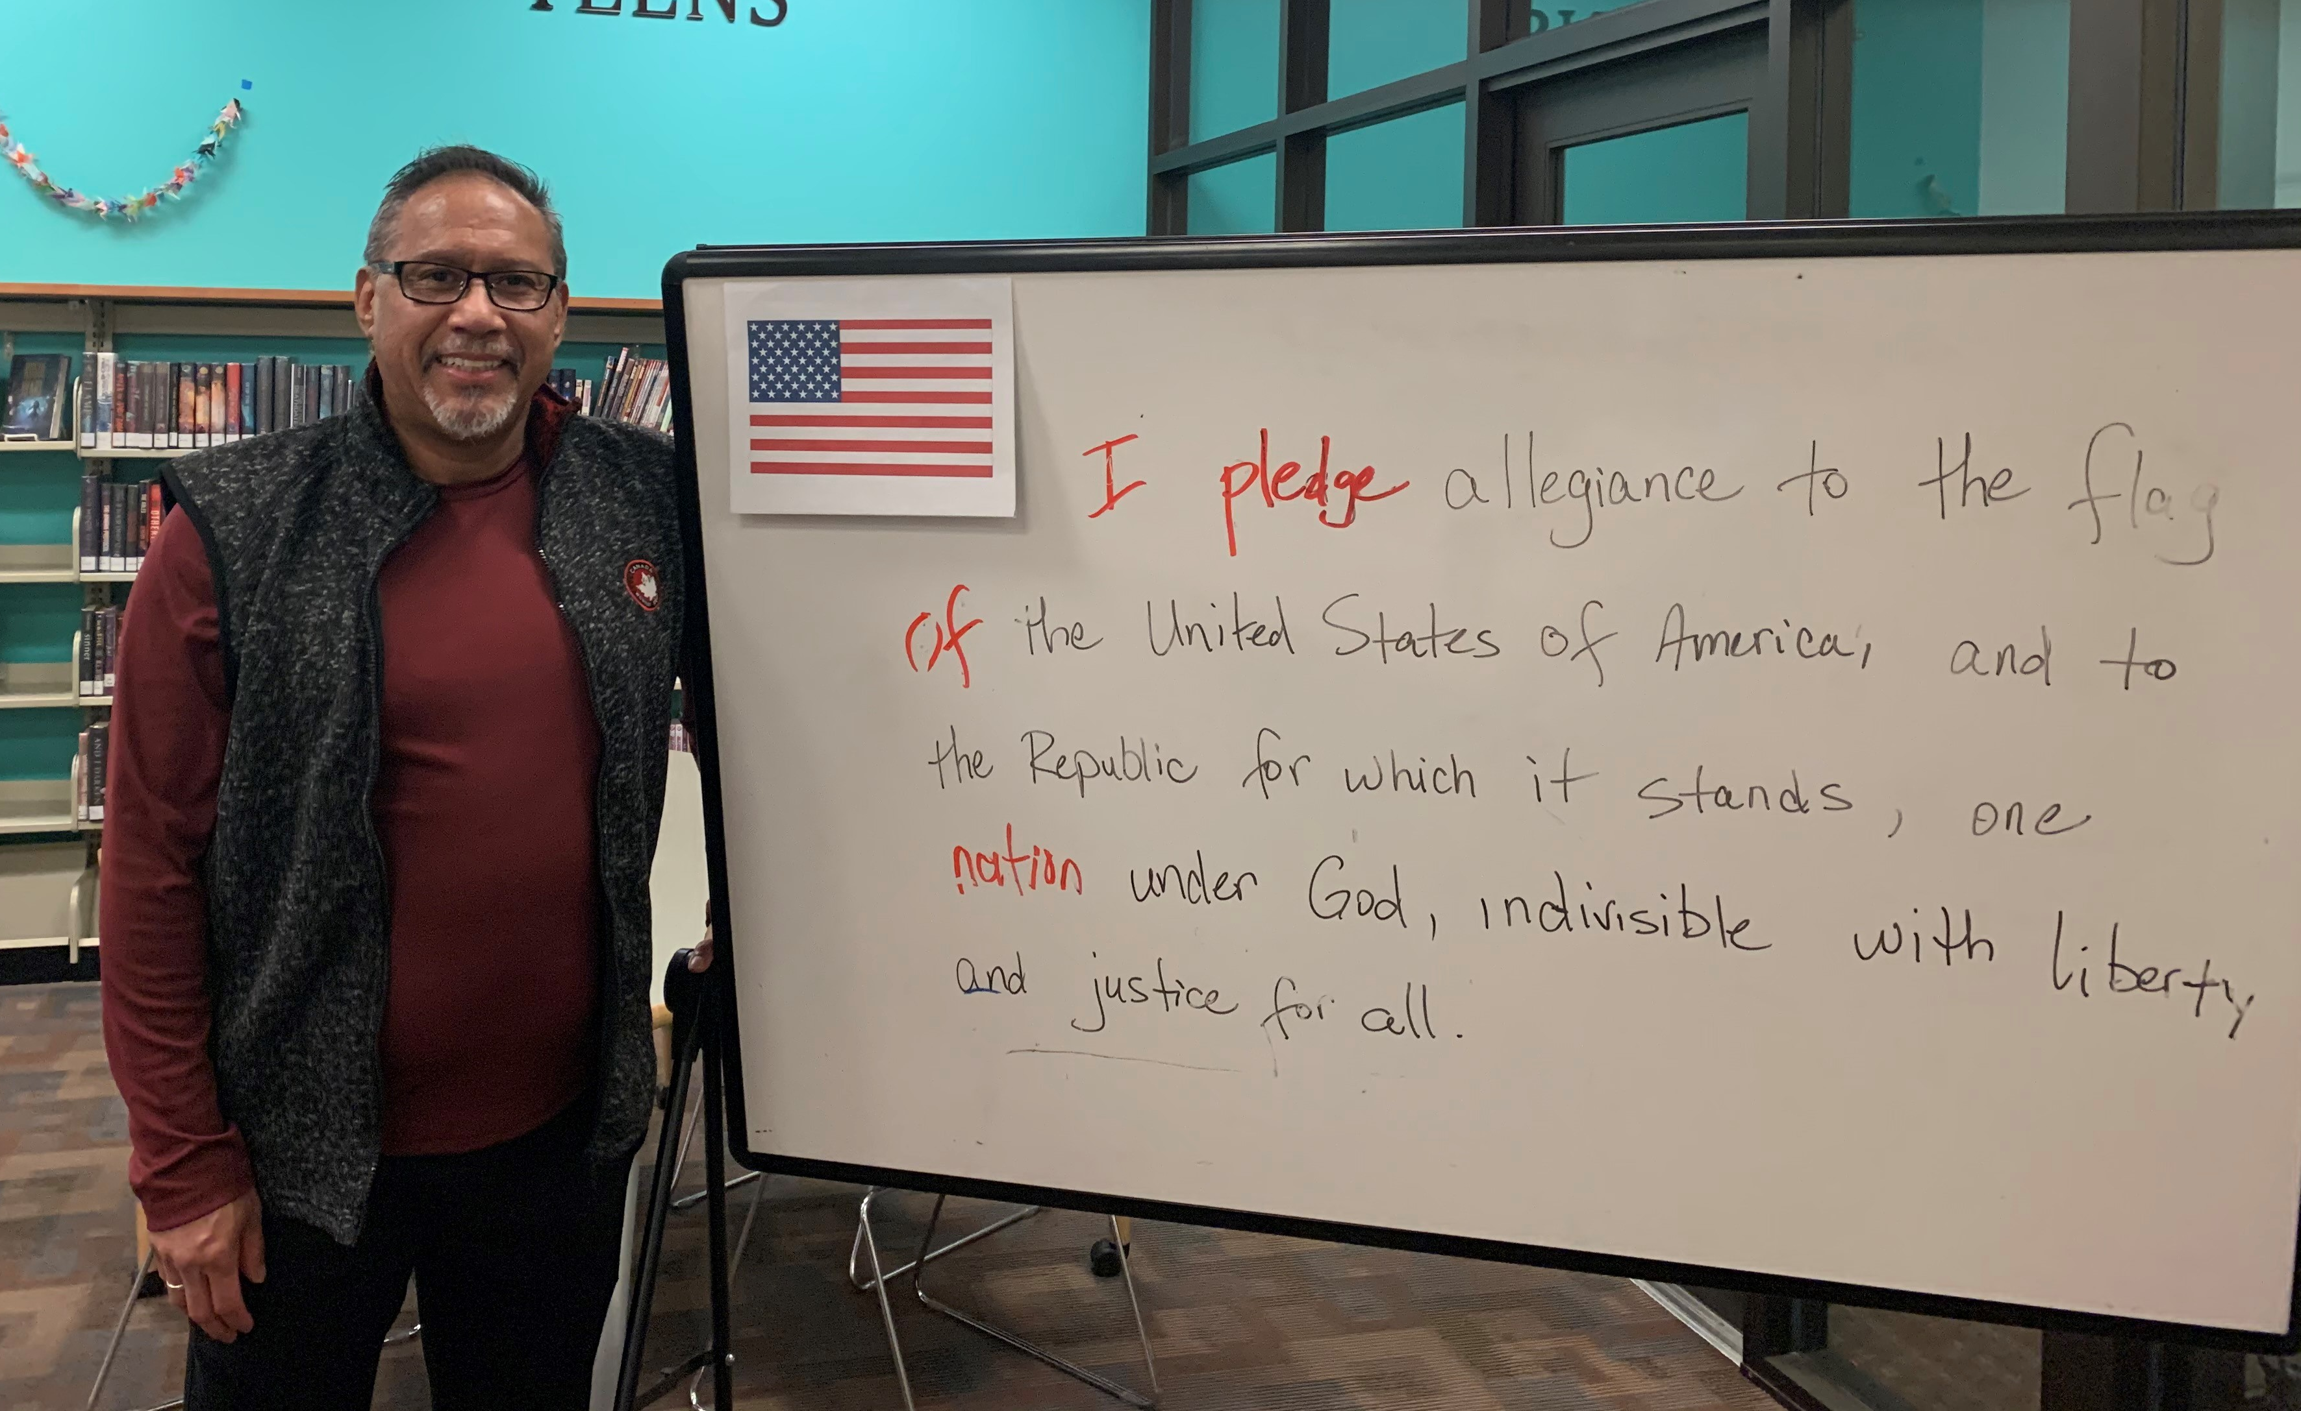
SDCL’s Guiding Principles
Energize
We champion civic engagement and support individuals in shaping the future of their communities.
10
Notes:
Our next Guiding Principle is:
Energize. We champion civic engagement and support individuals in shaping the future of their communities.
An important strategic initiative in the Energize principle is our continued collaboration with the Lemon Grove School District and local partner institutions to provide strong leadership opportunities for youth.
SDCL supports voting and democracy by partnering with the Registrar of Voters to make every library branch in our system a polling place. The Lemon Grove branch also served as a mail ballot drop-off site from February 26 to March 3 in the last election. We will be offering mail ballot drop off services at all SDCL locations in the upcoming presidential election.
Volunteers with the Friends of the Lemon Grove Library provide advocacy and fundraising that directly benefit the Lemon Grove Library and community. Last year alone, the Friends made over $7,000 available for our programs and collection while building a trust fund that will benefit the community for years to come.

Slide 11
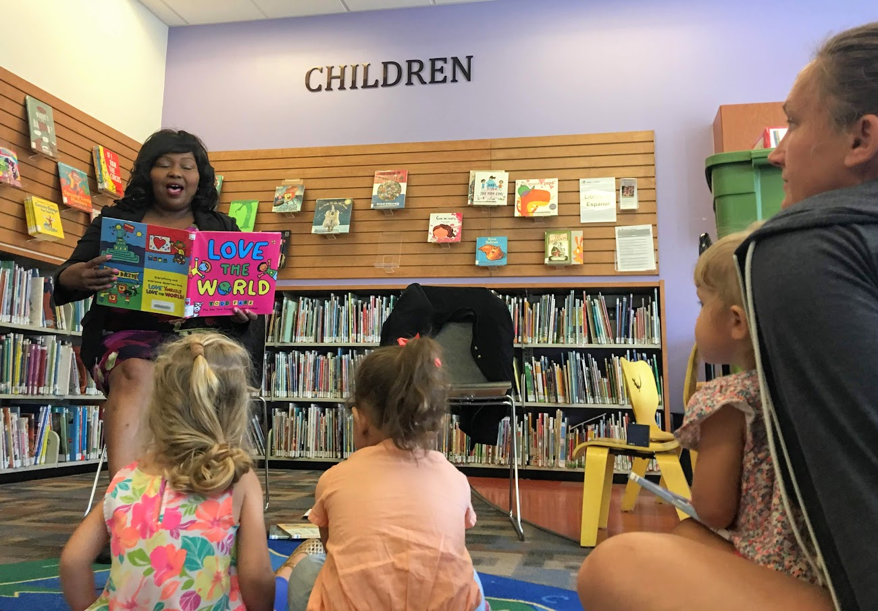
SDCL’s Guiding Principles
Read
We encourage reading in every way: to develop skills, nurture hope, and motivate a love of reading.
Notes:
Our third Guiding Principle, and the one most people think of when they consider the library, is:
Read. We encourage reading in every way: to develop skills, nurture hope, and motivate a love of reading.
SDCL now provides access to over 133,000 downloadable books, one of the largest collections in Southern California. You can download these books to your smartphone, tablet, or computer whenever and wherever you are. If you don’t have a library card, you can sign up for one instantly using your cell phone number to access this collection using our Instant Digital Card.
During the COVID-19 pandemic, the library increased our focus on digital access. In addition to our Instant Digital library cards, we also offer an e-card option, where customers enjoy expanded access to our databases, which include homework help, career guidance, video storybooks, and language learning tools.
Customers can now access a series of Book Shorts & Storytime Shorts on our website, where librarians offer book recommendations and virtual storytimes, complete with songs, literacy tips, and activity sheets.

Slide 12
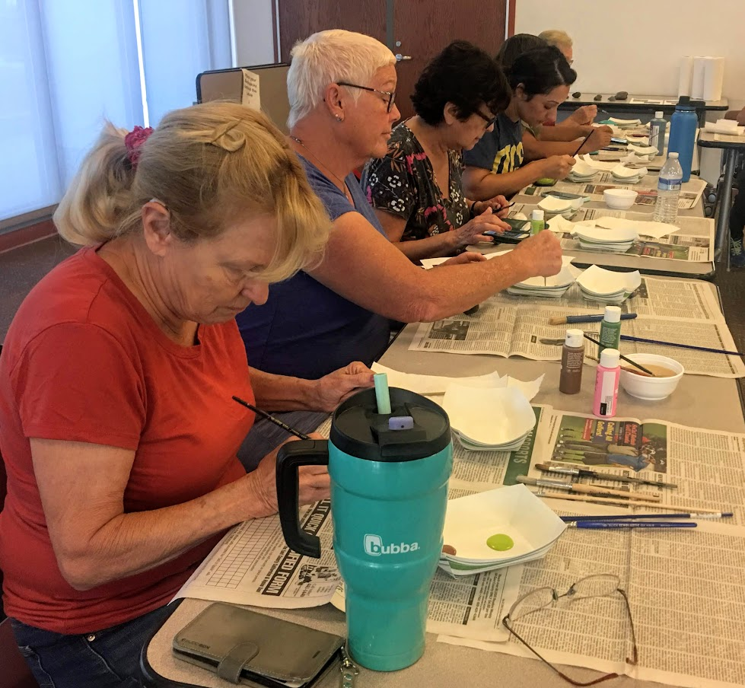
SDCL’s Guiding Principles
Create
We design opportunities to experience and enjoy culture and the arts as a creator and participant.
12
Notes:
Our fourth and final Guiding Principle is:
Create. We design opportunities to experience and enjoy culture and the arts as a creator and participant.
The library regularly assesses our program offerings through community feedback and partnerships to develop programming that reflects the diverse cultures we serve. For example, the library worked with the Lemon Grove Historical Society in August 2019 to host author Christy Hale at our branch. Her award-winning bilingual book, Todos Iguales/All Equal: A Ballad of Lemon Grove, chronicles the Lemon Grove incident. That title is now circulating within our system and proudly on display at the Lemon Grove branch.
We also believe in showcasing local creative talent through our rotating art displays and special artist lecture series. For example, artist Crystal Paris, who has recently worked with high-profile artists like Tina Knowles and Kanye West, hosted a tween fashion collage workshop on March 11 targeted to middle school students – she gave them an opportunity to create self portraits that reflect their own diverse beauty.

Slide 13
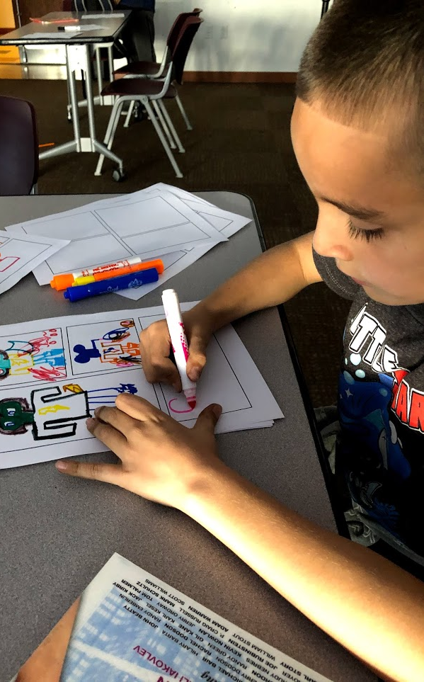
By the Numbers
Total # of Checkouts | Circulation – Electronic Materials | Program Attendance | Programs Offered | Branch Visitors
88,522 | 28,763 | 21,032 | 632 | 115,587
Fiscal year 2019-2020
Notes:
For the 2019-2020 fiscal year, the Lemon Grove Library clocked in with these approximate statistics.
88,522 books, movies, and CDs were checked out this fiscal year.
Over 28,000 of those checkouts were of downloadable ebooks and audiobooks, and our digital circulation continues to grow.
We hosted over 600 programs for kids, teens, and adults that were attended by over 21 thousand people. The majority of these programs are sponsored by the Friends of the Lemon Grove Library thanks to donations and bookstore purchases by local residents.
We helped over 115,000 visitors – that’s approx. 317 people each day.

Slide 14
Community Asset Plan
Market segmentation via Gale Analytics
Community surveying
Focus groups
14
Notes:
Thank you for letting me share SDCL’s new Strategic Plan. To further tailor our services to the Lemon Grove community, we have created a Community Asset Plan. This plan utilizes market segmentation data from Gale Analytics, as well as community surveys and focus groups to create a detailed analysis of the Lemon Grove community and how the library can best serve local needs and interests. The map you see here shows us where our cardholders are located and how many Lemon Grove residents use our library. We utilized this demographic information and Census data along with community feedback, to formulate our own strategic initiatives that are geared towards the Lemon Grove community specifically. I look forward to sharing our branch Strategic Plan with you in the future.

Slide 15
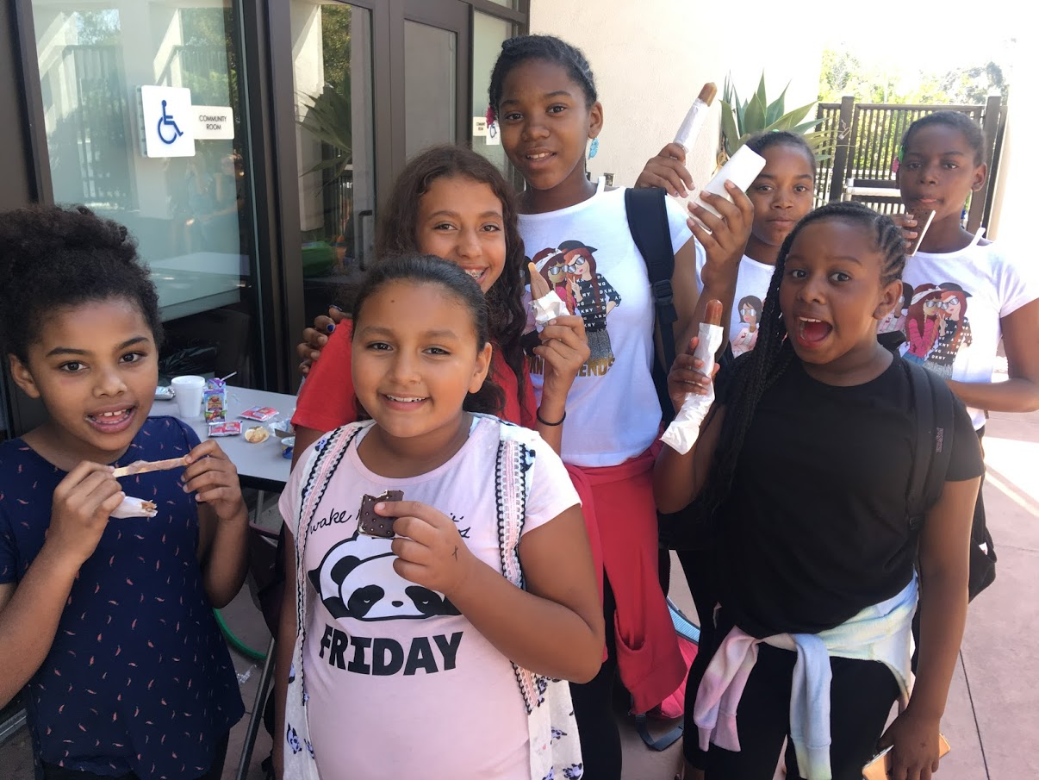
Thank You
Laura Mendez
Branch Manager
Lemon Grove Library
(619) 463-9819
laura.mendez@sdcounty.ca.gov
Notes:
On behalf of San Diego County Library and the entire Lemon Grove team, I’d like to thank the City of Lemon Grove for partnering with us and giving us the support we need to bring the best possible library services to local residents.
Thank you all for your time this evening and I’d be happy to answer any questions you may have about the library.

Slide 16
PUBLIC COMMENT Public Comment is due to the City Clerk via email 24 hours prior to the meeting. To email the City Council your comments following the meeting please send to: schapel@lemongrove.ca.gov

Slide 17
CITY COUNCIL ORAL COMMENTS AND REPORTS ON MEETINGS ATTENDED AT THE EXPENSE OF THE CITY

Slide 18
CITY MANAGER REPORT

Slide 19
1. CONSENT CALENDAR
Notes:
An annual progress report on General Plan implementation is required by State Law and must be submitted to the City Council, Governor’s Office of Planning and Research (OPR), and the California Department of Housing and Community Development by April 1st of each year.

Slide 20
2. REPORT TO COUNCIL Video Federation and Integration; SafeSanDiego – Lemon Grove Presented by: Mike Rand, Sheriff’s Lieutenant
Notes:
An annual progress report on General Plan implementation is required by State Law and must be submitted to the City Council, Governor’s Office of Planning and Research (OPR), and the California Department of Housing and Community Development by April 1st of each year.

Slide 21

History
After an extensive search for a program that will allow the Sheriff’s Department to more efficiently address crime, Community Connect was identified as a valuable asset towards public safety through video federation.
The Sheriff’s Department will begin a pilot project in Lemon Grove utilizing this new technology.

Slide 22
Functionality
Federation is the sharing of aggregate data imagery into an easy to use program that can be accessed by deputy sheriffs in the field.
The data imagery is made available through a partnership with local businesses which voluntarily share their video camera systems with law enforcement.
The imagery is “owned” by the business, and simply placed into a format that allows appropriate Sheriff staff to view it.

Slide 23
SafeSanDiego-Lemon Grove
In order to give the program a local feel, it was named SafeSanDiego-Lemon Grove.
As this program moves into other cities, it will be appropriately named with a local theme.

Slide 24
Law Enforcement Calls for Service
In 2019, deputies handled:
13,015 calls for service
6,785 self-initiated activities
1,207 arrests
Lemon Grove is the busiest patrol station in the County of San Diego
SafeSanDiego-Lemon Grove will assist with providing a higher and more effective and efficient level of service.

Slide 25
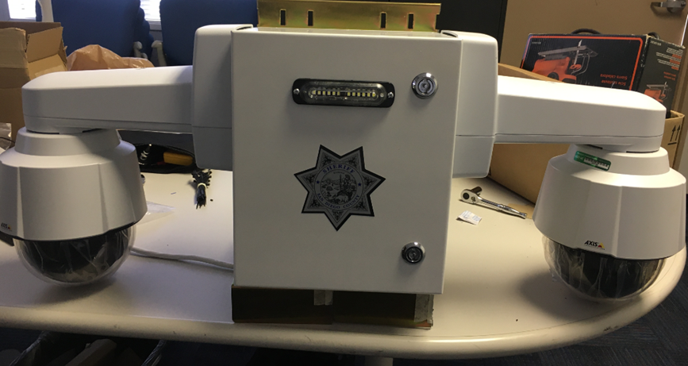
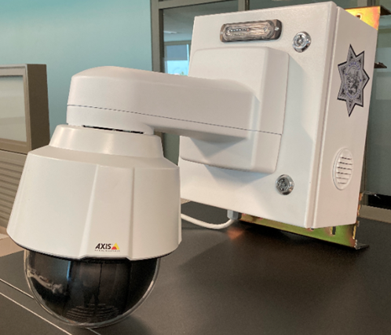
Sheriff Owned Cameras
The Sheriff’s Department built 5 camera housings that include a total of 9 cameras. These will be placed strategically throughout the city.
Designed to be high profile.

Slide 26
City/Sheriff Camera Locations
Lemon Grove Promenade Park (2)
Berry Street Park (2)
Lemon Grove Park (2)
Firefighters Skate Park (1)
Massachusetts & Broadway (2)

Slide 27
Imagery for Law Enforcement Use
The Sheriff cameras are very high quality cameras that provide crisp images. Many local businesses also have high quality cameras.

Slide 28
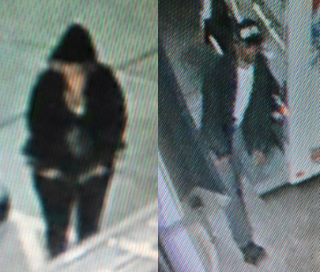
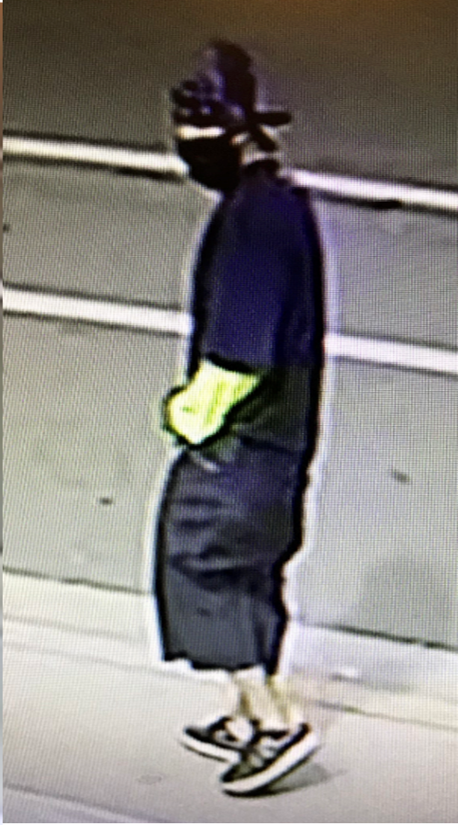
Blurry images:

Slide 29
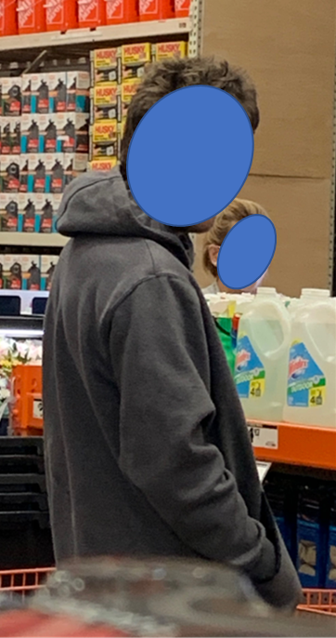
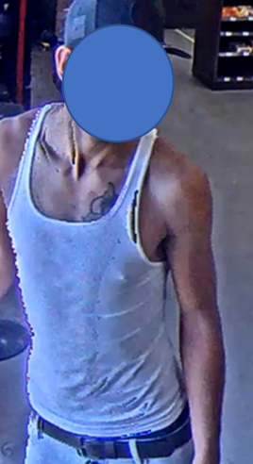
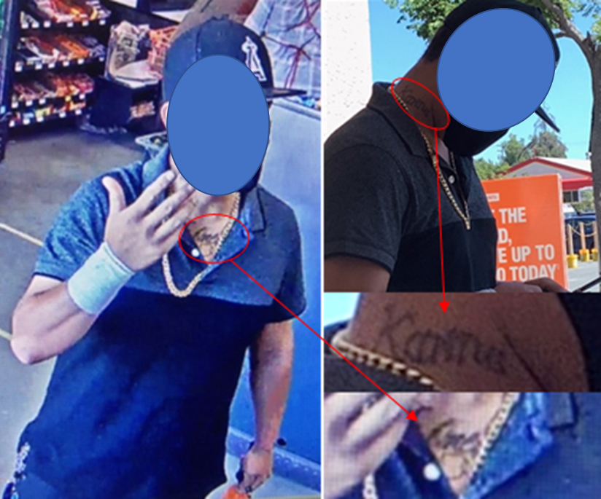
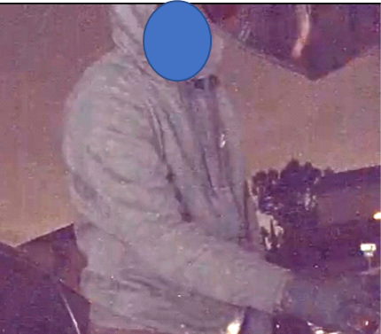
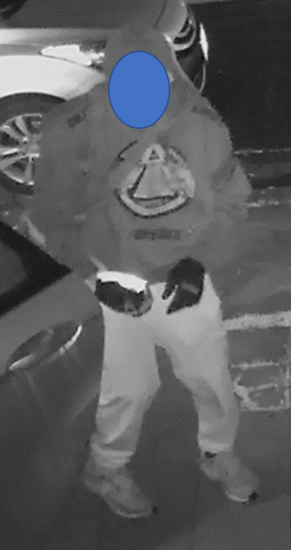
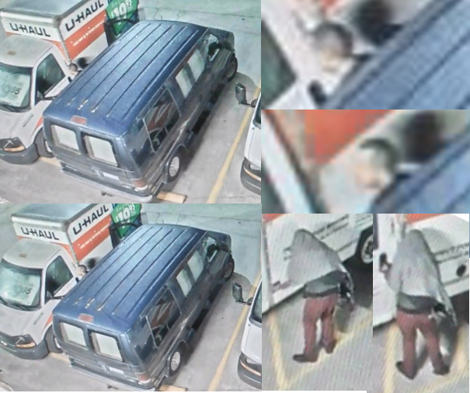
Sharper images:

Slide 30
What's the benefit?
To deter crime from occurring.
To create a partnership between the Sheriff’s Department and the community to enhance safety and reduce victimization in the city of Lemon Grove.
Increase officer safety when responding to a call for service.

Slide 31
Policy
Sheriff’s Policy 6.136, “Video Federation and Integration” was created earlier this year.

Slide 32
Public Outreach
Lemon Grove City Council on October 1, 2019 at a regularly scheduled city council meeting.
Lemon Grove Sheriff's, Coffee with the Community on October 3, 2019.
Community Forum on December 19, 2019 at the Lemon Grove Library.
Neighborhood Watch Meetings

Slide 33
Potential Federated Camera Locations
Trolley platforms.
Local businesses.
Residences.

Slide 34
What's next?
Continuing to inform the community and community buy-in.
Infrastructure placement.

Slide 35
Questions??

Slide 36
Recommendation: Receive Report and Provide Direction to Staff Regarding Safe San Diego Lemon Grove Pilot Project.
Notes:
An annual progress report on General Plan implementation is required by State Law and must be submitted to the City Council, Governor’s Office of Planning and Research (OPR), and the California Department of Housing and Community Development by April 1st of each year.

Slide 37
3. General Plan Housing Element Update Presented by: Noah Alvey, Community Development Manager
Notes:
Thank you Madame Mayor and members of the City Council. Again, this is Noah Alvey, manager for the Community Development Department.
This report is a status update regarding the General Plan Housing Element

Slide 38
Background
Housing Element updates occur every eight years
The current Housing Element expires at the end of 2020
State law requires that the Housing Element update be completed by April, 2021
Notes:
The Housing Element is part of the City’s General Plan and sets forth the policies and programs to address the housing needs of all households in the City.
State law requires that every City update their Housing Element every eight years, with the current Housing Element expiring at the end of 2020.
Staff have begun the process of updating the Housing Element for the next planning period which must be completed by April, 2021.

Slide 39
Housing Element Components
Housing Needs Assessment
Constraints Analysis
Past Performance
Housing Sites Inventory
Housing Resources
Policies and Programs
Community Outreach
Notes:
The Housing Element includes 7 major components
Housing Needs Assessment: Includes demographic and housing need information
Constraints Analysis which analyzes existing and potential constraints to the development of housing
An Evaluation of Past Performance looks at the City’s progress in implementing the policies and programs set forth in the prior Housing Element.
Housing Sites Inventory and Analysis identifies sites available for development or redevelopment that are appropriately zoned to support housing
Housing Resources: Identifies financial and other resources available to support housing development, especially affordable housing.
Policies and Programs: Establishes new policies and programs designed to address the housing needs identified; and
Community Outreach which includes community involvement efforts done as part of the Housing Element update process

Slide 40
Regional Housing Needs Assessment (RHNA)
City appeal rejected
Final plan approved on July 10, 2020
Litigation expected
Notes:
The Regional Housing Needs Assessment or RHNA allocation will be an important part of the Housing Element update.
The San Diego Association of Governments (SANDAG) Board of Directors approved a RHNA plan on July 10, 2020 after rejecting an appeal by the City.
The SANDAG Board decision on the RHNA plan is now expected to be the subject of litigation.
Work on the inventory of sites is underway and will proceed even if litigation occurs in order to comply with State deadlines for completing the Housing Element update.

Slide 41
Schedule
State law requires that the Housing Element update be completed by April, 2021
SANDAG Board requested a 6-month extension
Public review draft near the end of 2020, if the extension is not granted
Notes:
State law requires that the Housing Element update be completed by April of 2021.
Due to COVID-19 related impacts and an inability to conduct in-person meetings, the SANDAG Board sent a letter to the State requesting a six month time extension
If an extension is granted, staff will use the time extension to conduct additional public outreach.
If the time extension is not granted, staff will complete the sites inventory and publish a public review draft of the Housing Element
near the end of 2020 followed by ongoing public outreach and hearings in early 2021.

Slide 42
Recommendation:
Receive and file the General Plan Housing Element Update
Notes:
No action is needed on this item and it is recommended that the City Council receive and file the report.
This concludes staff’s update and we are available to answer questions.

Slide 43
4. REPORT TO COUNCIL City Manager Employment Contract and Performance Evaluation Timeline Presented by: Kristen Steinke, City Attorney
Notes:
An annual progress report on General Plan implementation is required by State Law and must be submitted to the City Council, Governor’s Office of Planning and Research (OPR), and the California Department of Housing and Community Development by April 1st of each year.

Slide 44
Recommendation: Receive and File.
Notes:
An annual progress report on General Plan implementation is required by State Law and must be submitted to the City Council, Governor’s Office of Planning and Research (OPR), and the California Department of Housing and Community Development by April 1st of each year.

Slide 45
CLOSED SESSION 1. PUBLIC EMPLOYEE EMPLOYMENT Government Code Section 54957 Performance Evaluation: City Manager The Clerk will pause the meeting at this time and will continue meeting upon the reconvene of the City Council from Closed Session.
Notes:
An annual progress report on General Plan implementation is required by State Law and must be submitted to the City Council, Governor’s Office of Planning and Research (OPR), and the California Department of Housing and Community Development by April 1st of each year.

Slide 46
ADJOURNMENT

